Slide 1
Lesson 10 - When Do I Use An Object?
Mr Mack 2019

Slide 2
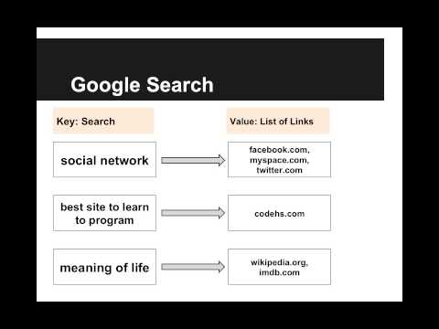
When Do I Use An Object?

Slide 3
If you want to be able to look up a value by index (ex: get the 0th, 1st, or 2nd element), should you use a map?
yes
no, array/list would be better

Slide 4
What are good questions to ask when deciding whether to use a Map / Object for our data?
Should I be able to look something up by key?
Can I find a (key, value) mapping that would be useful?
Do I care about the order?
All of the above

Slide 5
If you care about the order of data, should the data be stored in a map?
yes
no

Slide 6
If you want to be able to look up a value by key (ex: get the definition for a specific word), should you use a map?
yes
no

Slide 7
Example: Facebook Friend Lists
This is an example for this lesson. You are encouraged to play around with it, run and change the code, and learn how it works. When you are done, click continue to go to the next problem.

Slide 8
Example: Does the Key Exist?
This is an example for this lesson. You are encouraged to play around with it, run and change the code, and learn how it works. When you are done, click continue to go to the next problem.

Slide 9
Exercise 5.10.1: Text Messages
In this exercise, you will write a program to send text messages to friends.
First, you need to decide what kind of data structure to use to store the text messages. Given a friend’s name, you should be able to look up every text message you’ve sent to that friend. You should also be able to easily add a new message to the list of messages you’ve sent to a friend.
Your job is to create a variable textMessages that will keep track of every message you send. Spend some time thinking about what kind of data structure textMessages should hold. Draw out on paper what the structure will look like.
Then you’ll write a function sendMessage(textMessages, friendName, message) that updates textMessages to store the message you just sent to friendName.
Then you’ll write a function getMessages(textMessages, friendName) that will return a list of every message you’ve sent to friendName, in the order that you sent them.

